Slide 1
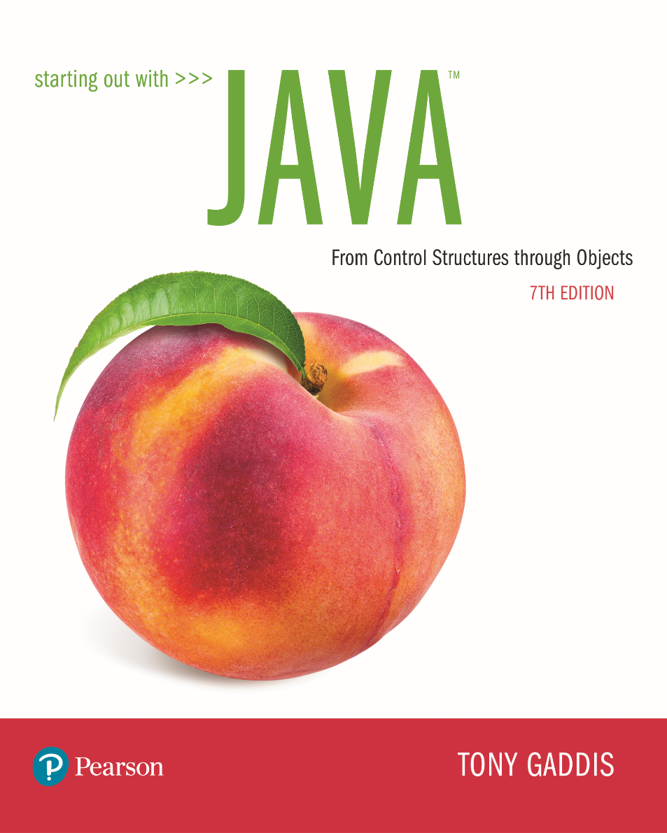

Slide 2
Examples’ Source Code
Source Code for examples presented in these slides can be found on:
Blackboard->Course Content->Source Code Of The Book Examples

Slide 3
Module 4 Topics
2.14 Dialog Boxes - Swing
JOptionPage Class – Message and Input Dialog
Dialog Boxes – JavaFX
Alert, TextInput, Choice
3.10 The system.out.printf Method
3.11 Creating Objects with the DecimalFormat Class
4.11 Generating Random Numbers with the Random Class
Using the API
Design: Data Element and Driver classes

Slide 4
Dialog Boxes - Swing
A dialog box is a small graphical window that displays a message to the user or requests input.
A variety of dialog boxes can be displayed using the JOptionPane class.
Two of the dialog boxes are:
Message Dialog - a dialog box that displays a message.
Input Dialog - a dialog box that prompts the user for input.

Slide 5
The JOptionPane Class - Swing
The JOptionPane class is not automatically available to your Java programs.
The following statement must be before the program’s class header:
import javax.swing.JOptionPane;
This statement tells the compiler where to find the JOptionPane class.

Slide 6
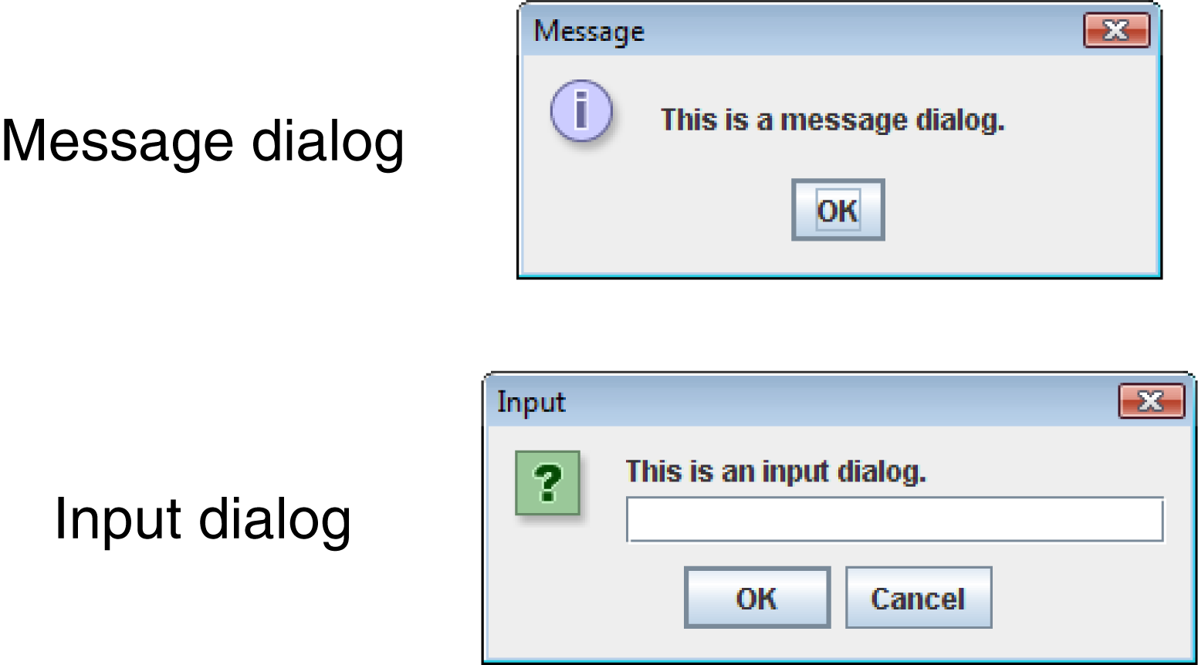
The JOptionPane Class - Swing
The JOptionPane class provides methods to display each type of dialog box.

Slide 7
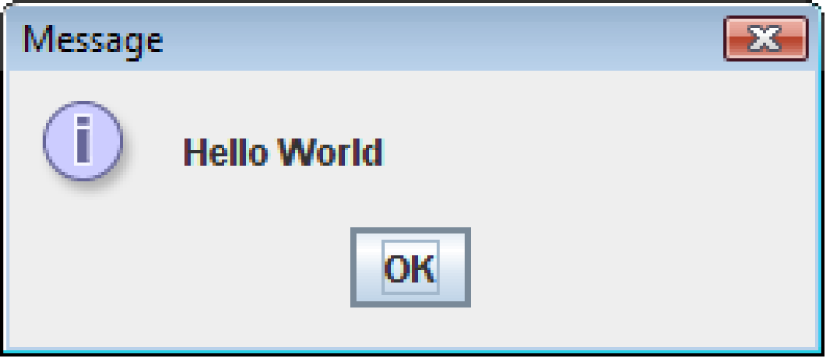
Message Dialogs - Swing
JOptionPane.showMessageDialog method is used to display a message dialog.
JOptionPane.showMessageDialog(null, "Hello World");
The first argument will be discussed later.
The second argument is the message that is to be displayed.

Slide 8
Input Dialogs - Swing
An input dialog is a quick and simple way to ask the user to enter data.
The dialog displays a text field, an Ok button and a Cancel button.
If Ok is pressed, the dialog returns the user’s input.
If Cancel is pressed, the dialog returns null.

Slide 9
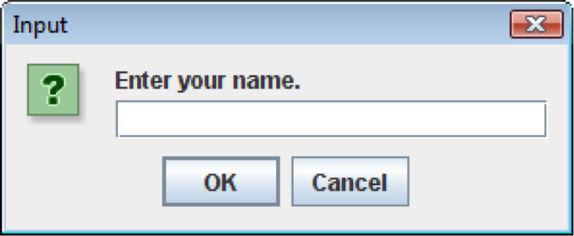
Input Dialogs - Swing
String name;
name = JOptionPane.showInputDialog(
"Enter your name.");
The argument passed to the method is the message to display.
If the user clicks on the OK button, name references the string entered by the user.
If the user clicks on the Cancel button, name references null.

Slide 10
Converting a String to a Number
The JOptionPane’s showInputDialog method always returns the user's input as a String
A String containing a number, such as “127.89”, can be converted to a numeric data type.

Slide 11
The Parse Methods
Each of the numeric wrapper classes, (covered in Chapter 10) has a method that converts a string to a number.
The Integer class has a method that converts a string to an int,
The Double class has a method that converts a string to a double, and
etc.
These methods are known as parse methods because their names begin with the word “parse.”

Slide 12
The Parse Methods
// Store 1 in bVar.
byte bVar = Byte.parseByte("1");
// Store 2599 in iVar.
int iVar = Integer.parseInt("2599");
// Store 10 in sVar.
short sVar = Short.parseShort("10");
// Store 15908 in lVar.
long lVar = Long.parseLong("15908");
// Store 12.3 in fVar.
float fVar = Float.parseFloat("12.3");
// Store 7945.6 in dVar.
double dVar = Double.parseDouble("7945.6");

Slide 13
Reading an Integer with an Input Dialog
int number;
String str;
str = JOptionPane.showInputDialog(
"Enter a number.");
number = Integer.parseInt(str);

Slide 14
Reading a double with an Input Dialog
double price;
String str;
str = JOptionPane.showInputDialog(
"Enter the retail price.");
price = Double.parseDouble(str);
See example: PayrollDialog.java

Slide 15
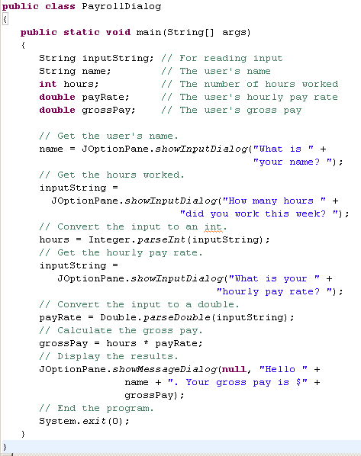

TRY IT!

Slide 16
Dialog Boxes - JavaFX
A dialog box is a small graphical window that displays a message to the user or requests input.
A variety of dialog boxes can be displayed using the Alert class.
Four of these dialog boxes are:
Information Dialog - a dialog box that displays a message.
Warning Dialog - a dialog box that displays a warning.
Error Dialog – a dialog box that displays an error.
Confirmation Dialog – a dialog box that displays options for a user to select

Slide 17
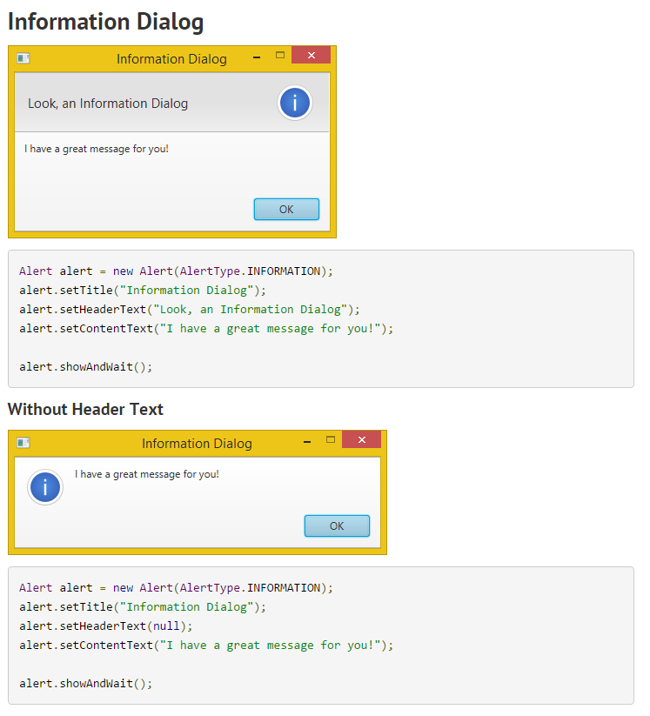

Slide 18
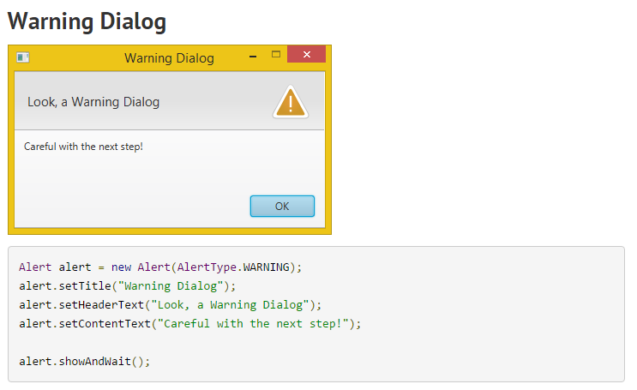

Slide 19
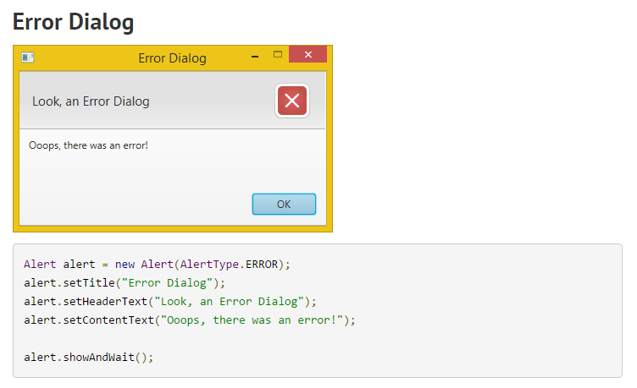

Slide 20
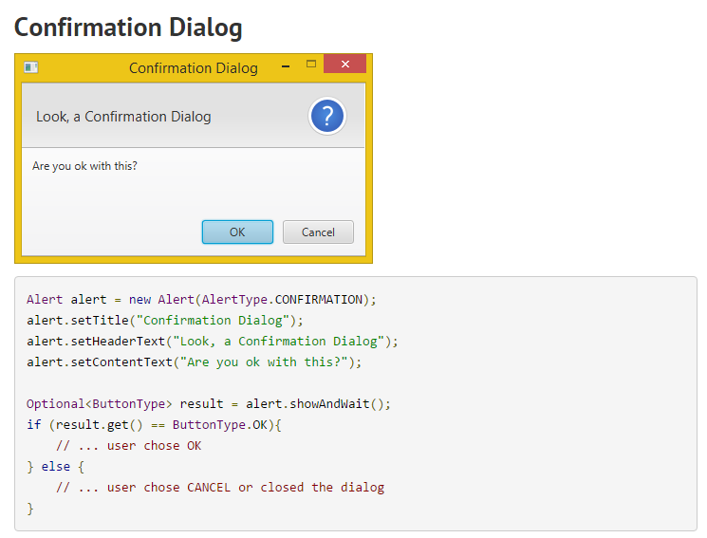

Slide 21
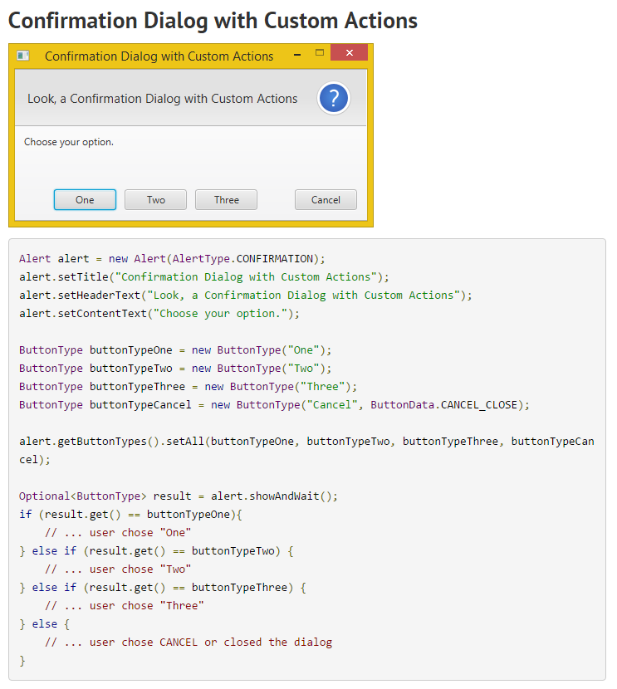

Slide 22
Dialog Boxes - JavaFX
Dialog boxes can also be displayed using the TextInputDialog and ChoiceDialog classes.
The TextInputDialog displays a text field, an Ok button and a Cancel button.
If Ok is pressed, the user’s input can be extracted.
If Cancel is pressed, the result is false.

Slide 23
Dialog Boxes - JavaFX
The ChoiceDialog displays a ComboBox, an Ok button and a Cancel button.
If the user selects something from the ComboBox and presses Ok, the user’s input can be extracted.
If Cancel is pressed, of the user doesn’t select something from the ComboBox, the result is false.

Slide 24
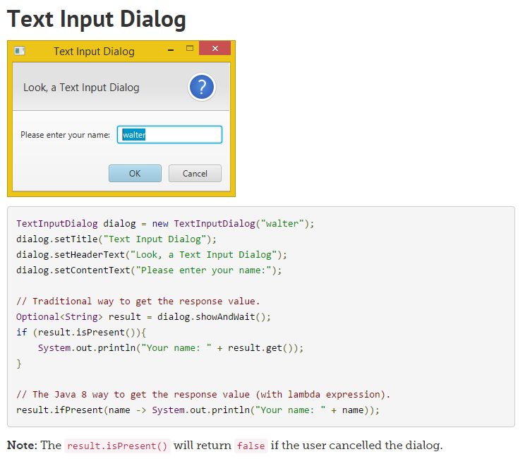

Slide 25
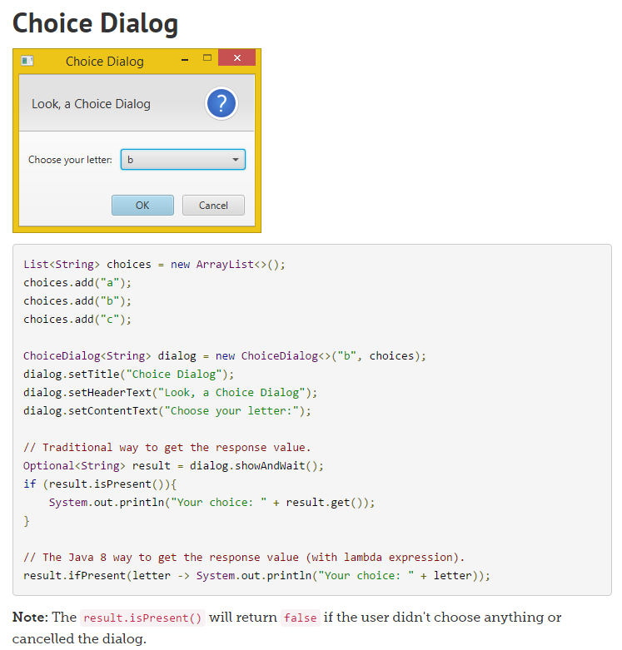

Slide 26
The System.exit Method
A program that uses JOptionPane or Alert or TextInput or ChoiceInput does not automatically stop executing when the end of the main method is reached.
Java generates a thread, which is a process running in the computer, when a one of these objects is created.
If the System.exit method is not called, this thread continues to execute.

Slide 27
The System.exit Method
The System.exit method requires an integer argument.
System.exit(0);
This argument is an exit code that is passed back to the operating system.
This code is usually ignored, however, it can be used outside the program:
to indicate whether the program ended successfully or as the result of a failure.
The value 0 traditionally indicates that the program ended successfully.

Slide 28
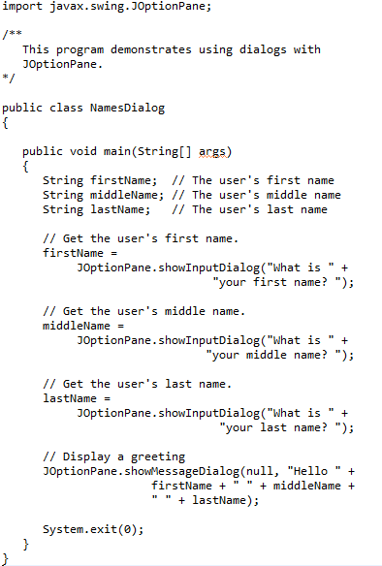
Example of using JOptionPane

Slide 29
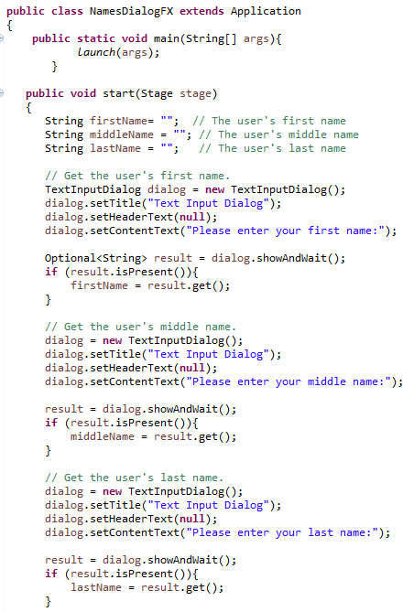
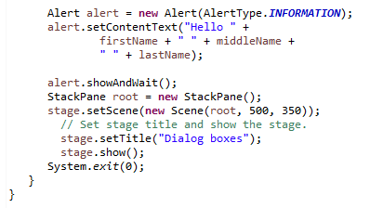
Example of using TextInputDialog and Alert

Slide 30
The printf Method
You can use the System.out.printf method to perform formatted console output.
The general format of the method is: System.out.printf(FormatString, ArgList);
Format string – shows how output should be formatted
Format specifiers – % followed by letter describing format

Slide 31
The printf Method
System.out.printf(FormatString, ArgList);
FormatString is a string that contains text and/or special formatting specifiers.
ArgList is optional. It is a list of additional arguments that will be formatted according to the format specifiers listed in the format string.

Slide 32
Formatting Numbers - printf
Use the printf method of the PrintStream class. Uses a format
string and format specifiers
System.out.printf(“Total: %5.2f”, total);
Fixed point number with width of 5 and 2 decimal places
System.out.printf(“%-6s%5.2f%n”, “Tax”, total);
Means left justified string of width 6
%n is a new line
** The parameter values and the format specifiers must match

Slide 33
Formatting Numbers - printf
Format specifiers
Format types
d – decimal
x – hexadecimal
o – octal
f – fixed floating point
e – exponential floating point
g – general floating point
s – string
n – new line
Format Flags
Left alignment
0 show leading zeros
+ show plus sign for positive numbers
( put negative numbers in parentheses
, show decimal separators
^ convert to uppercase

Slide 34
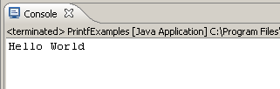
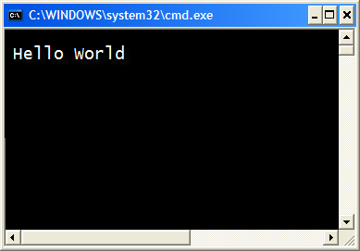
The printf Method
System.out.printf("Hello World\n");
A simple example:

Slide 35
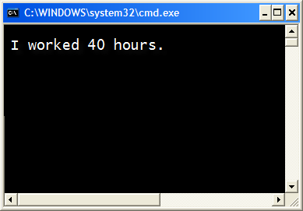
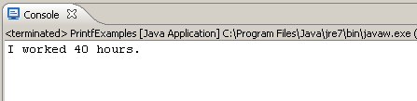
The printf Method
int hours = 40;
System.out.printf("I worked %d hours.\n", hours);
System.out.printf("I worked %d hours.\n", hours);
The %d format specifier indicates that a decimal integer will be printed.
The contents of the hours variable will be printed in the location of the %d format specifier.

Slide 36
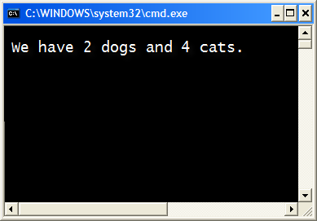

The printf Method
int dogs = 2, cats = 4;
System.out.printf("We have %d dogs and %d cats.\n",
dogs, cats);

Slide 37
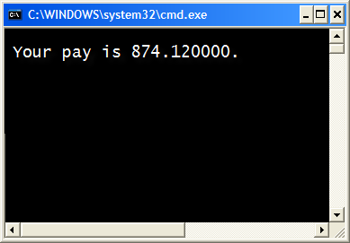
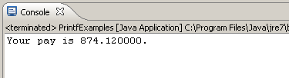
The printf Method
double grossPay = 874.12;
System.out.printf("Your pay is %f.\n", grossPay);
System.out.printf("Your pay is %f.\n", grossPay);
The %f format specifier indicates that a floating-point value will be printed.
The contents of the grossPay variable will be printed in the location of the %f format specifier.

Slide 38
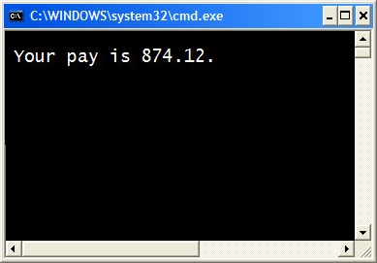

The printf Method
double grossPay = 874.12;
System.out.printf("Your pay is %.2f.\n", grossPay);
System.out.printf("Your pay is %.2f.\n", grossPay);
The %.2f format specifier indicates that a floating-point value will be printed, rounded to two decimal places.

Slide 39
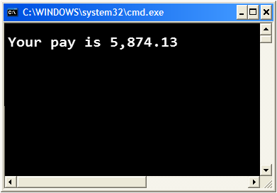

The printf Method
Another example:
double grossPay = 5874.127;
System.out.printf("Your pay is %,.2f.\n", grossPay);
The %,.2f format specifier indicates that a floating-point value will be printed with comma separators, rounded to two decimal places.

Slide 40
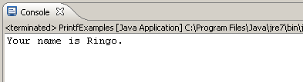

The printf Method
Another example:
String name = "Ringo";
System.out.printf("Your name is %s.\n", name);
The %s format specifier indicates that a string will be printed.

Slide 41
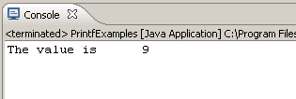
The printf Method
int number = 9;
System.out.printf("The value is %6d\n", number);
The %6d format specifier indicates the integer will appear in a field that is 6 spaces wide.
Specifying a field width:

Slide 42
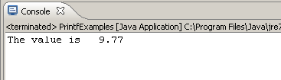
The printf Method
double number = 9.76891;
System.out.printf("The value is %6.2f\n", number);
The %6.2f format specifier indicates the number will appear in a field that is 6 spaces wide, and be rounded to 2 decimal places.

Slide 43
The System.out.printf Method
See examples:
Columns.java
CurrencyFormat.java

Slide 44
The String.format Method
The String.format method works exactly like the System.out.printf method, except that it does not display the formatted string on the screen.
Instead, it returns a reference to the formatted string.
You can assign the reference to a variable, and then use it later.

Slide 45
The String.format Method
The general format of the method is:
String.format(FormatString,ArgumentList);
FormatString is a string that contains text and/or special formatting specifiers.
ArgumentList is optional. It is a list of additional arguments that will be formatted according to the format specifiers listed in the format string.

Slide 46
The String.format Method
See examples:
CurrencyFormat2.java
CurrencyFormat3.java

Slide 47
Decimal Format
It is often necessary to format values in certain ways so that they can be presented properly
The Java standard class library contains classes that provide formatting capabilities
The NumberFormat class allows you to format values as currency or percentages
The DecimalFormat class allows you to format values based on a pattern
Both are part of the java.text package

Slide 48
Formatting Output
The NumberFormat class has static methods that return a formatter object
getCurrencyInstance()
getPercentInstance()
Each formatter object has a method called format that returns a string with the specified information in the appropriate format

Slide 49
import java.util.Scanner;
import java.text.NumberFormat
public class Purchase
{
//-----------------------------------------------------------------
// Calculates the final price of a purchased item using values
// entered by the user.
//-----------------------------------------------------------------
public static void main (String[] args)
{
final double TAX_RATE = 0.06; // 6% sales tax
int quantity;
double subtotal, tax, totalCost, unitPrice;
Scanner scan = new Scanner (System.in);
NumberFormat fmt1 = NumberFormat.getCurrencyInstance();
NumberFormat fmt2 = NumberFormat.getPercentInstance();
System.out.print ("Enter the quantity: ");
quantity = scan.nextInt();
System.out.print ("Enter the unit price: ");
unitPrice = scan.nextDouble();
subtotal = quantity * unitPrice;
tax = subtotal * TAX_RATE;
totalCost = subtotal + tax;
// Print output with appropriate formatting
System.out.println ("Subtotal: " + fmt1.format(subtotal));
System.out.println ("Tax: " + fmt1.format(tax) + " at "
+ fmt2.format(TAX_RATE));
System.out.println ("Total: " + fmt1.format(totalCost));
}
}
Sample Output:
Enter the quantity: 5
Enter the unit price: 2.39
Subtotal: $11.95
Tax: $0.72 at 6%
Total: $12.67

Slide 50
Formatting Output
The DecimalFormat class can be used to format a floating point value in various ways
For example, you can specify that the number should be truncated to three decimal places
The constructor of the DecimalFormat class takes a string that represents a pattern for the formatted number

Slide 51
Formatting Output - DecimalFormat
Formatting pattern:
0 – Mandatory
# - Optional
. – decimal place
, - separator
% - puts in % format (multiplies by 100)
Examples:
“00.00”
“#0.0#”
“#,##0.00”
“#0%”

Slide 52
import java.util.Scanner;
import java.text.DecimalFormat;
public class CircleStats
{
//-----------------------------------------------------------------
// Calculates the area and circumference of a circle given its
// radius.
//-----------------------------------------------------------------
public static void main (String[] args)
{
int radius;
double area, circumference;
Scanner scan = new Scanner (System.in);
System.out.print ("Enter the circle's radius: ");
radius = scan.nextInt();
area = Math.PI * Math.pow(radius, 2);
circumference = 2 * Math.PI * radius;
// Round the output to three decimal places
DecimalFormat fmt = new DecimalFormat ("0.###");
System.out.println ("The circle's area: " + fmt.format(area));
System.out.println ("The circle's circumference: "
+ fmt.format(circumference));
}
}

Slide 53
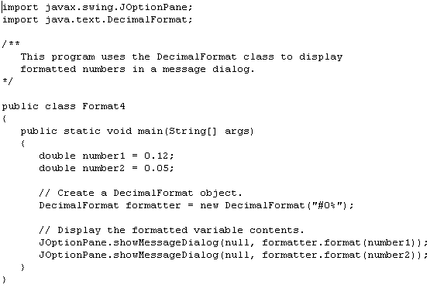
What is the output?
12%
5%

Slide 54
Generating Random Numbers with the Random Class
Some applications, such as games and simulations, require the use of randomly generated numbers.
The Java API has a class, Random, for this purpose. To use the Random class, use the following import statement and create an instance of the class.
import java.util.Random;
Random randomNumbers = new Random();

Slide 55
Some Methods of the Random Class
Method | Description
nextDouble() | Returns the next random number as a double. The number will be within the range of 0.0 and 1.0.
nextFloat() | Returns the next random number as a float. The number will be within the range of 0.0 and 1.0.
nextInt() | Returns the next random number as an int. The number will be within the range of an int, which is –2,147,483,648 to +2,147,483,648.
nextInt(int n) | This method accepts an integer argument, n. It returns a random number as an int. The number will be within the range of 0 to n.
See example: RollDice.java

Slide 56
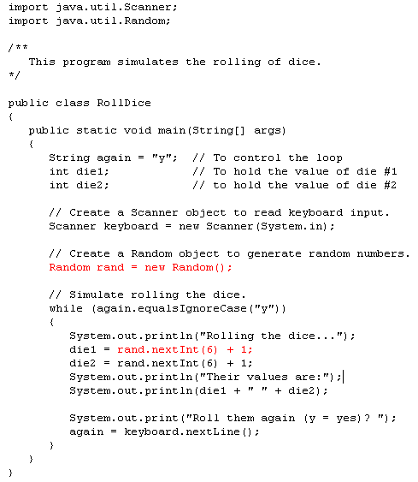

Slide 57
Using the API
API: Application Programming Interface
API documentation: lists classes and methods in the Java library
http://docs.oracle.com/javase/7/docs/api/

Slide 58
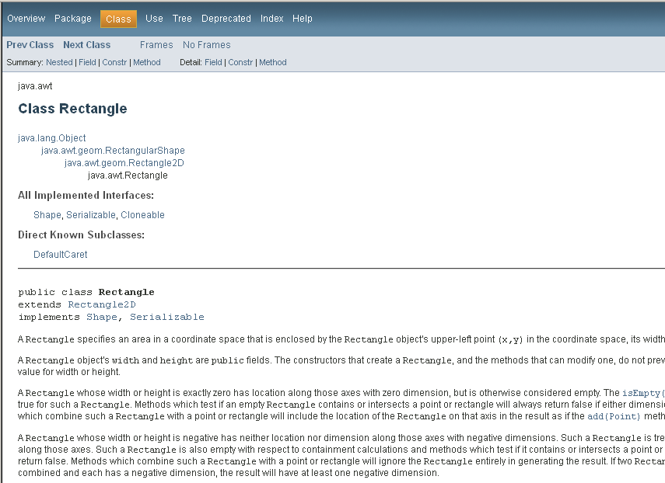
The API Documentation for the Rectangle Class
This is the package the Rectangle class is in

Slide 59
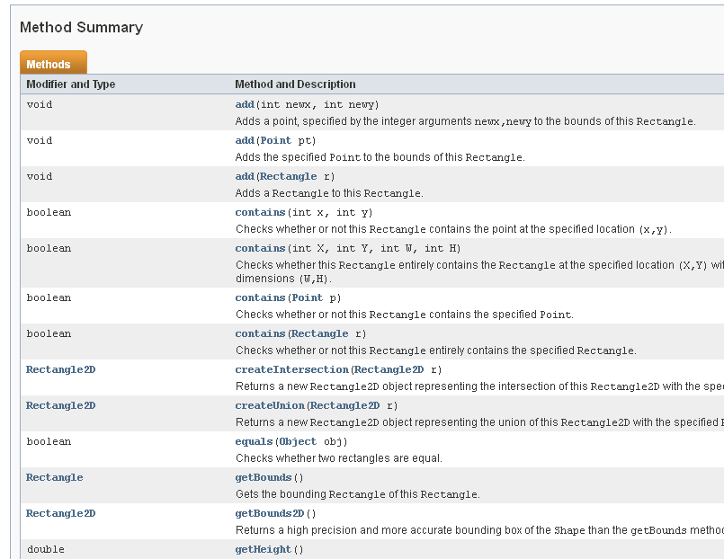
Method Summary

Slide 60
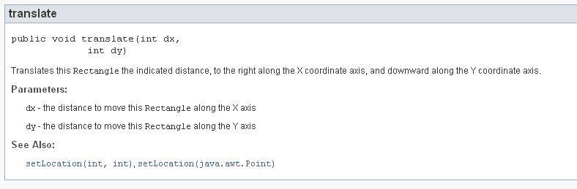
Detailed Method Description
The detailed description of a method shows:
The action that the method carries out
The parameters that the method receives
The value that it returns (or the reserved word void if the method doesn’t return any value)

Slide 61
In the API documentation of the String class, look at the description of the trim method. What is the result of applying trim to the string
" Hello, Space ! "? (Note the spaces in the string.)
Answer: "Hello, Space !" – only the leading and trailing spaces are trimmed.

Slide 62
In the API documentation of the String class, look at the description of the equals method. What is the result in the following statements?
String greeting = "Hello, World!";
String river = "Mississippi";
Boolean result;
result = greeting.equals(river);
result = river.equals(“Mississippi”);
result = greeting.equals(“Hello”);
False
True
False
Can be used in selection statements:
if (river.equals(“Mississippi”))
{
System.out.println(“Mississippi River”);
}

Slide 63
Design: Data Element and Driver Classes
Data Element class
No main method
Represents a noun (person, place, thing, concept)
Contains data (instance data)
Contains getters and setters and other methods for processing the data
Driver class. Also referred to as a “client”
Creates an object of the worker class
Uses the methods of the worker class
Contains the main method
Extracts input from the user
Displays output to the user

Slide 64
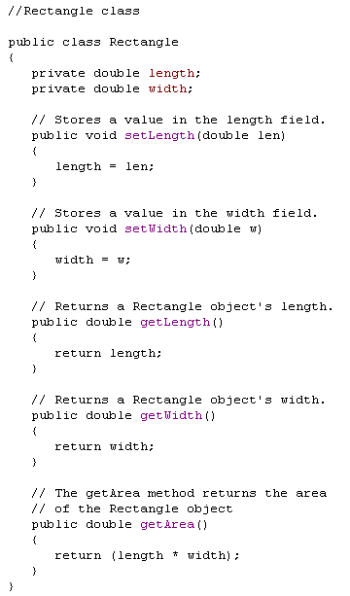
Data Element and Driver Classes
Data Element class
No main method
Represents a noun (person, place, thing, concept)
Contains data (instance data)
Contains getters and setters and other methods for processing the data
Represents a noun (person, place, thing, concept)
Contains data (instance data)
Contains getters and setters and other methods for processing the data

Slide 65
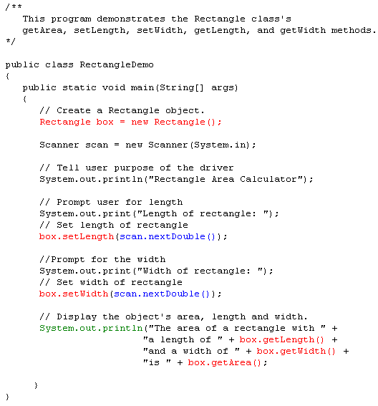
Data Element and Driver Classes
Driver class. Also referred to as a “client”
Creates an object of the data element class
Uses the methods of the data element class
Contains the main method
Extracts input from the user
Displays output to the user

Slide 66
TRY IT!

Slide 67
Data Element and Driver Classes
One of the most important things in software engineering is knowing how to design your classes so that they will be reusable and scalable. The first design technique we looked at is the data element/driver class design.
Here is a brief synopsis on the concept of data element and driver classes.
A driver class is the one that contains main.
The job of the driver class is to:
1. Gather data from the user
2. Pass that data to the appropriate methods of the data element class
3. Receive information from the methods of the data element class
4. Display the information to the user (formatting is usually required here)

Slide 68
Data Element and Driver Classes
The data element class performs the operations for a single object (person, place, thing, concept).
The data element class contains the following:
data needed to do the calculations and processing, instance variables.
accessor and mutator methods, also referred to as getters and setters, there is usually a getter and a setter for each instance variable
contructors, usually at least two where one is the no-arg constructor
methods that do the calculations and processing

